Slide 1
How does your posture affect the way you use your voice?

Slide 2
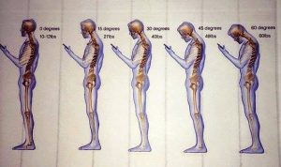

Slide 3
Good speaking posture helps you to breathe properly and project your voice effectively. It also provides a good starting point from which to gesture or move your body in any direction. And by helping you to feel both alert and comfortable, it helps decrease nervous tension and minimize random, distracting movements.

Slide 4
What Is Good Posture? To carry yourself with good posture, keep your back straight, chest out, and shoulders back. It might feel a bit strange at first if you're used to walking and sitting slouched.

Slide 5
GESTURES -it is a specific bodily movement that reinforces a verbal message or conveys a particular thought or emotion.

Slide 6
-must be purposeful -they must be visible to the audience. -it must mean the same thing to the audience that they mean to the speaker. -they must reflect what’s being said

Slide 7
-Clarify and support your words. -Dramatize your ideas. -Lend emphasis and vitality to the spoken word. -Help dissipate nervous tension. -Stimulate audience participation.

Slide 8
Voice Tone -it is all about speaking clearly and confidently. When you have good voice tone you can better communicate with other people which is so important especially conveying a message.

Slide 9
FACIAL EXPRESSIONS

